Slide 1
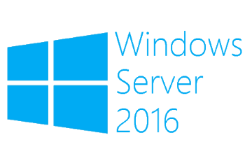
Introduction to IPAM
Megaseries

Slide 2
General
New to Windows Server 2012, much improved in Windows Server 2012 R2 and further improved in Windows Server 2016
Is a free solution with which you can manage IP address blocks, DHCP scopes and DNS entries
Easy to set up and manage as it is integrated in the Server Manager and in Windows Server 2016 offers more Powershell CmdLets
In WS 2016 DNS management has some enhancements like managing Zones and Resource Records

Slide 3
IPAM Functions
Address space management
Virtual address space management: works with System Center VMM to manage your virtual address infrastructure
Multi-server discovery, management and monitoring
Audit
Role based access control (new in Windows Server 2012 R2 and enhanced in Windows Server 2016)

Slide 4
IPAM data storage
In Windows Server 2016 IPAM data can be stored in a Windows Internal Database or in a Microsoft SQL Server database
The space that the database takes up depends on the environment complexity so the more ranges, ip addresses users and devices you have the more space the data will take up
This link can help you calculate your storage needsfor IPAM: https://docs.microsoft.com/en-us/previous-versions/windows/it-pro/windows-server-2012-r2-and-2012/jj878312(v=ws.11)
Old event data can be deleted from IPAM through the GUI

Slide 5
Important terms
Address block – This is just a container for a big block of IPs from which we can then create ranges; usually blocks are well knows IP networks like 172.16.0.0/16
Address range – This is a subset of a block which can be represented by a DHCP scope or an IPAM managed address range; An example: 172.16.0.1-172.16.0.100 as a DHCP scope

Slide 6
More on IPAM
It is completely agentless
Most of its tasks are done with scripts that run as Scheduled Tasks
Can manage Windows Server 2008+ as OS and DC, DNS, DHCP and NPS as server roles
Data can be imported and exported with the GUI and with Powershell which also permits integration with other system
The IPAM server has local groups with which you can grant users different roles in IPAM (the old way of granting rights from Windows Server 2012; still exist also in 2016)

Slide 7
Role based access control
Uses roles, access scopes and access policies to allow you to define fine-grained control for users and groups of different objects in IPAM
Roles are IPAM operations; Windows Server 2016 has 8 already built-in and you can define as many custom roles as you need
Access scopes define the objects that users have access to so they define the administrative domain; An example of using scopes is creating a scope for each location in your environment
Access policies combine a role with a scope to grant users or groups permissions on certain IPAM objects

Slide 8

https://www.youtube.com/channel/UCcZ-jLbPwNr8E_v9-65n8Iw https://github.com/itknowledge4

